Slide 1
Transparency and Reproducibility in Economics: Lessons learned from 1,000 papers
Lars Vilhuber
Cornell University
The opinions expressed in this talk are solely the authors, and do not represent the views of the U.S. Census Bureau, the American Economic Association, or any of the funding agencies.
© Lars Vilhuber .
Notes:
I am going to
Very briefly describe the background we are coming from
Make note of the various elements of progress (and the broader picture) of open science
Describe some of the ongoing challenges
Provide some guidance based on the lessons learned in the past year

Slide 2
3 Lessons (and many solutions)
Lesson 1: Computational empathy
Lesson 2: Data acumen
Lesson 3: Role of institutions

Slide 3
Let me expand that a bit…

Slide 4
For students and researchers
0. Do not necessarily learn from previous papers
Have computational empathy for …
Track data whenever used
Learn the basic … of programming
Learn to automate
Preserve it all (and version it too)

Slide 5
For institutions
(departments, schools, libraries, IT, universities)
Offer training in adapted tools
Highlight appropriate community or university sites
Provide streamlined access to some frequently used (open/commercial) tools

Slide 6
For faculty
Encourage students to learn skills you don’t know
Demand reproducibility when reviewing (articles, theses, intermediate reports from students, etc.)
Incentivize reproducibility

Slide 7
A bit of background

Slide 8

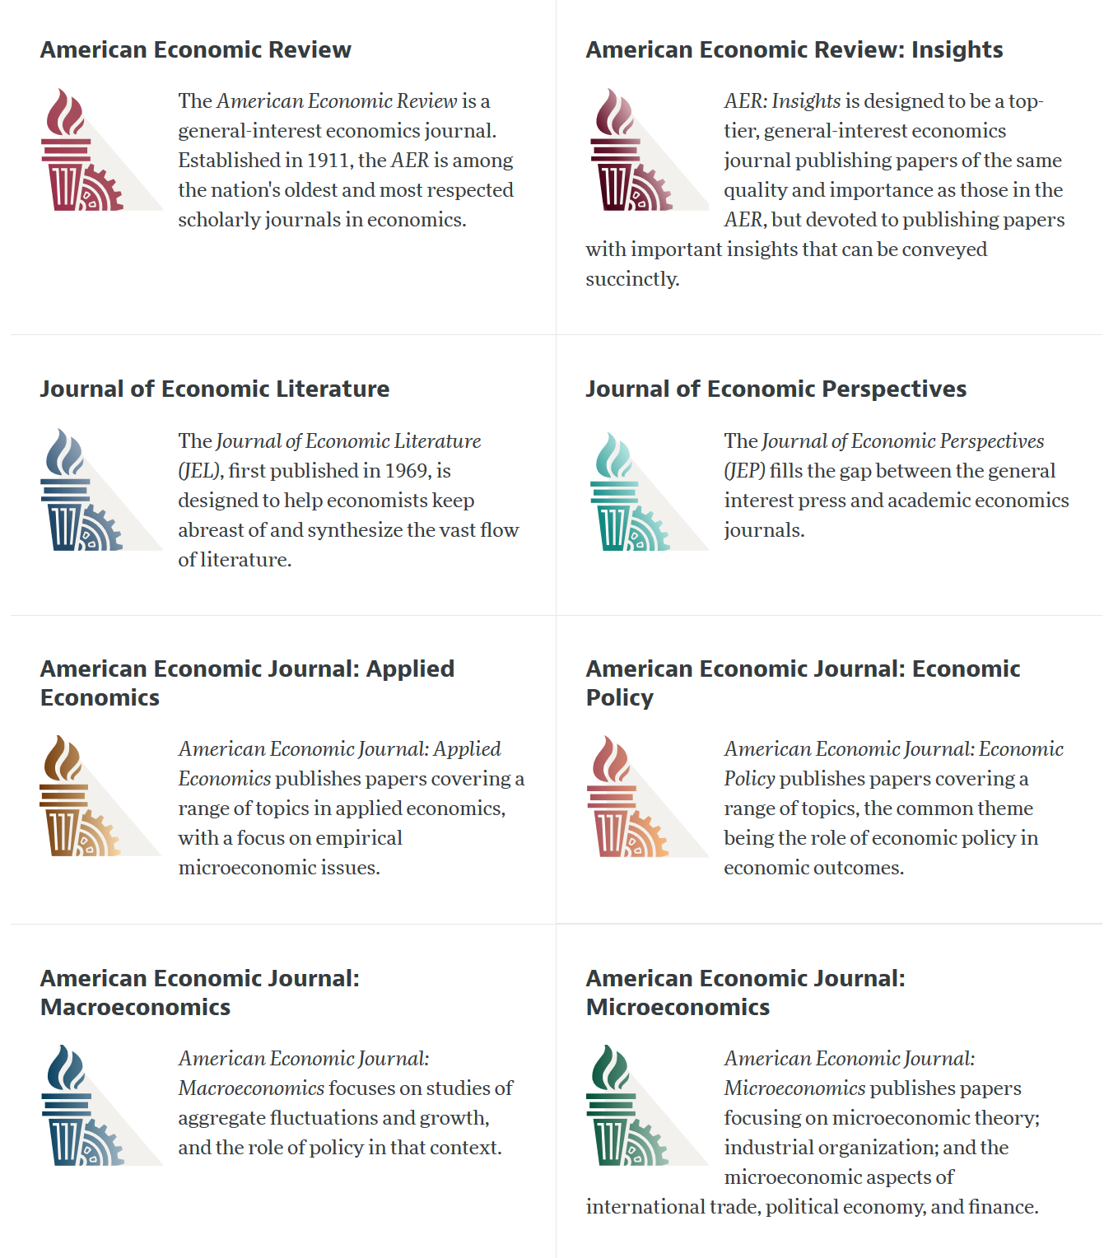

Slide 9
AEA Data & Code Availability Policy (2019)
It is the policy of the American Economic Association to publish papers only if the data used in the analysis are clearly and precisely documented and access to the data and code is clearly and precisely documented and is non-exclusive to the authors.
Authors of accepted papers that contain empirical work, simulations, or experimental work must provide, prior to acceptance, the data, programs, and other details of the computations sufficient to permit replication, as well as information about access to data and programs.

Slide 10
Current efforts at the AEA
Pre-emptively improve code archives
By conducting reproducibility checks when we can
By working with groups that conduct reproducibility checks when we cannot
Better archives
Greater transparency of the code and data archives
Better provenance tracking
Leave code where it is when appropriate
Leave data where it is almost always
Display that information
Notes:
Add logo from AEA

Slide 11
AEA Pre-Publication Verification
Every paper that receives a “conditional acceptance” is verified
Data citations
Quality of README
Quality of code
Reproducibility of code
Quality of metadata in the repository

Slide 12
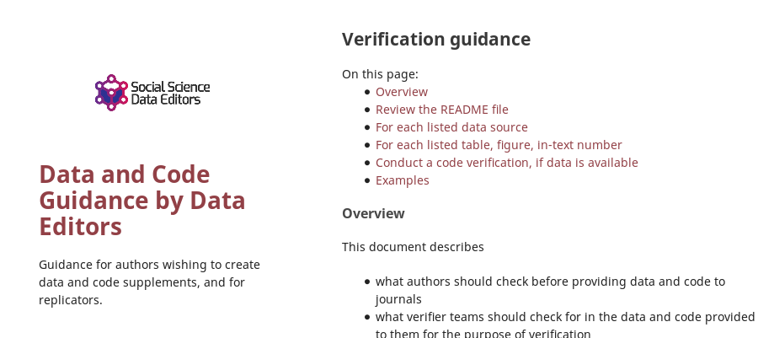

Action: Reproducibility Check

Slide 13
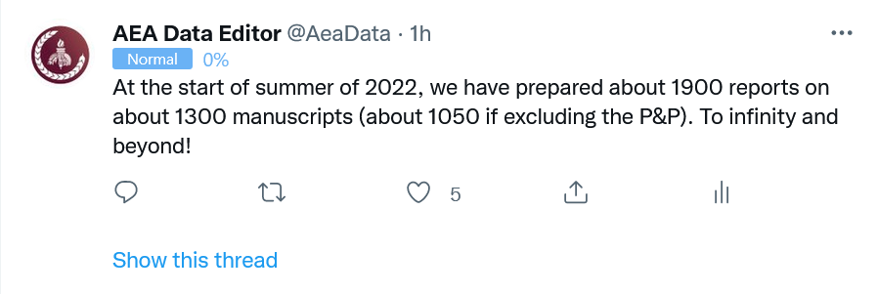
Stats on reproduced articles
Between July 16, 2019, and June 20, 2022, the AEA Data Editor team conducted
1900 assessments
for 1050 manuscripts (full papers)

Slide 14
A bit of my background

Slide 15
My experience
Creating statistical production system from research code (still running 15+ years later)
Working with confidential data (creating reproducible analyses, but also seeing how where others fail to do so)
Helped create and analyze synthetic data at scale (including configuring and managing the server to induce reproducible programming…)
Comfortable on Linux systems (since 1993), but also versed in MacOS and Windows (to see what others do…)
Comfortable running Stata, R, Python, Matlab, Julia, compiling Fortran and C with and without Makefiles, etc.
Configured departmental clusters (for myself, for colleagues, accommodating different usage patterns)

Slide 16
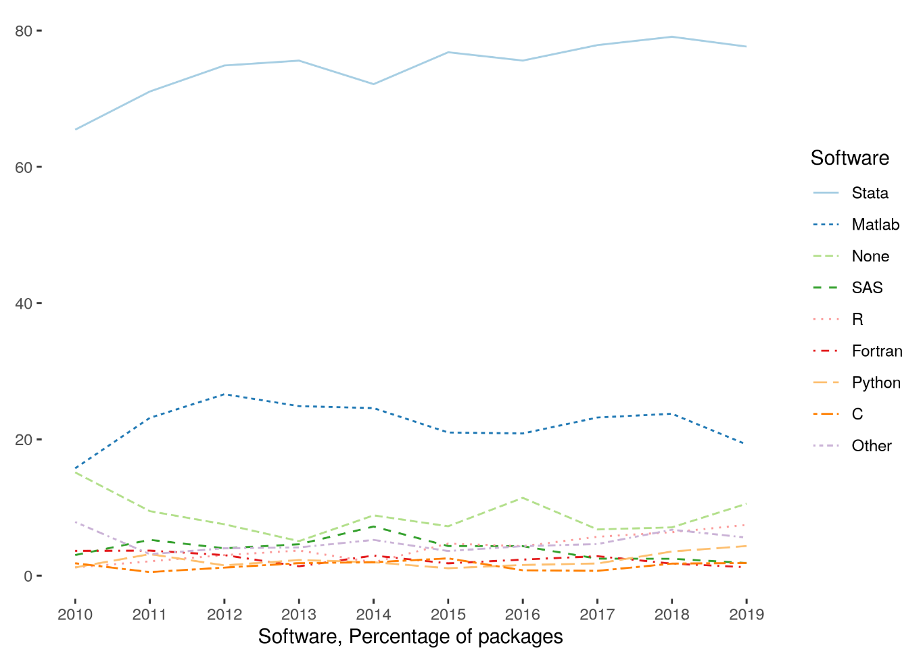
Very little diversity in software
Stata is the most popular statistical software in the journals of the AEA (72.96% of all supplements, 2010-2019)
followed by Matlab (22.45%)

Slide 17
Defining “reproducible research”
“Reproducibility” refers to the ability of a researcher to duplicate the results of a prior study using the same materials and procedures as were used by the original investigator.
Bollen et al. 2015. “Social, Behavioral, and Economic Sciences Perspectives on Robust and Reliable Science.” National Science Foundation.https://www.nsf.gov/sbe/AC_Materials/SBE_Robust_and_Reliable_Research_Report.pdf.

Slide 18


Ingredients of “research”
“Procedures” = computer code
“Materials (1)” = data
“Materials (2)” = computers

Slide 19
Lessons?

Slide 20
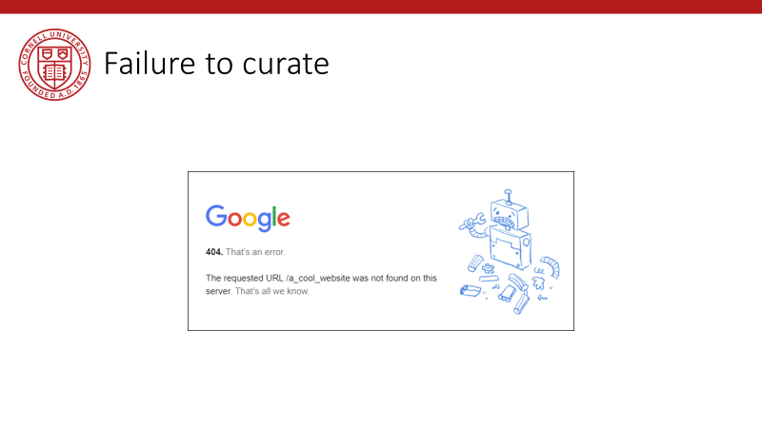
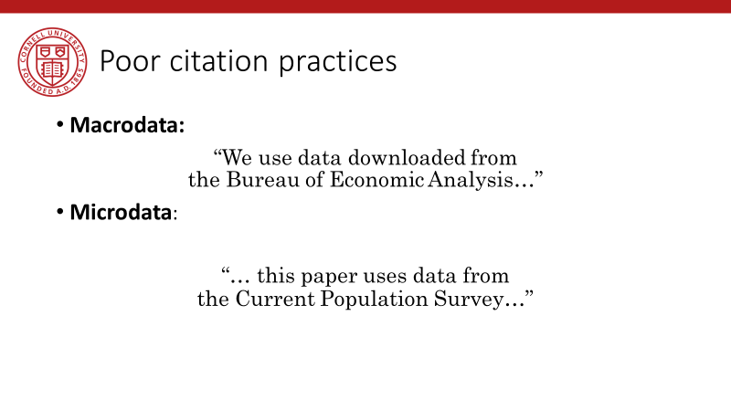
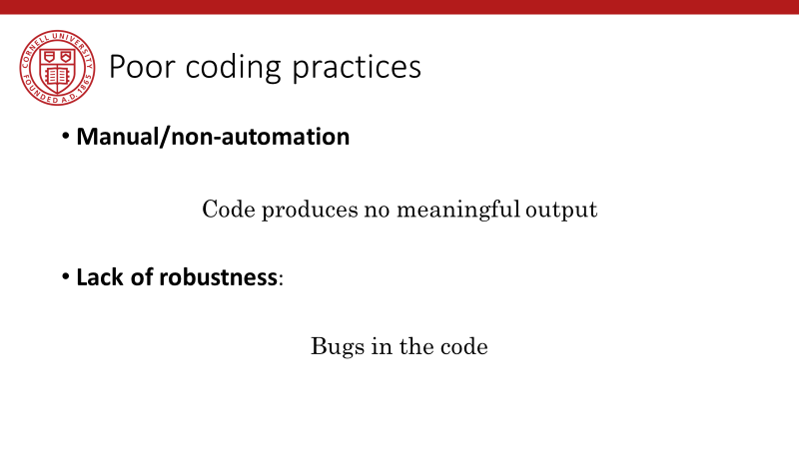
Back in 2019…

Slide 21
Observation 0
Researchers don’t…
Re-run their code before submitting
Don’t streamline (automate) enough
Are not careful about how they document data sources
Fail to curate their own data

Slide 22
Lessons!

Slide 23
Computational empathy

Slide 24
Lesson 1: Computational empathy
In the words of the slogan popularized by Buckheit and Donoho (1995),
“a scientific publication is [...] merely advertising of the scholarship: [...] the complete software development environment and the complete set of instructions which generated the figures.”

Slide 25
Lesson 1: Computational empathy
Put yourself in the position of the reader of the research compendium:
Can they understand those instructions?
Under what premises/ shared common knowledge?
What might they assume about the computing environment?
How concise or diffuse are the instructions?

Slide 26
Lesson 1: Computational empathy
Potential readers
You (in 4 years, between prepping 2 new courses, an R&R, a new child, and tenure coming up in 2 years)
Your RA (in 4 years, because you are… see above)
Your future readers who will cite you (in 4-10 years, who may want to extend or replicate your study, but won’t if it is too complex)

Slide 27
Lesson 1: Computational empathy
= “Pity the poor replicator”

Slide 28
Intermezzo

Slide 29
Observation 1
Social scientists do not read the manual
(beyond the first few pages)

Slide 30
Observation 1: Please read the manual
Persistent misconceptions
About setting working directories
How to record pathnames
How to leverage loops
How to leverage subroutines
How to pass parameters
How (and if) to use controller scripts

Slide 31
Observation 2
Social scientists love point-and-click interfaces (which are hard to reproduce)

Slide 32
Observation 2: point-and-click interfaces
This is reflected in
GIS (maps) that appear in papers
Data extraction tools
How to run software (any software)

Slide 33
Observation 1 and 2 are the result of a lack of Computational Empathy, and lead to high burden of reproducibility and replicability

Slide 34
Solutions?

Slide 35
Hold that thought, we will get there.

Slide 36
Data acumen

Slide 37
Data acumen
“the ability to understand data, to make good judgments about and good decisions with data, and to use data analysis tools responsibly and effectively”
National Academies of Sciences, Engineering, and Medicine. 2018. Data Science for Undergraduates: Opportunities and Options. Washington, DC: The National Academies Press. https://doi.org/10.17226/25104.

Slide 38
Lesson 2: Data acumen in the context of reproducibility
Two key components
Data provenance
Where did the data come from which I used?
Data preservation
Where do I put the data I generated?
What if the data I used are not “robustly preserved”?
What do you mean by that?

Slide 39
Data provenance

Slide 40
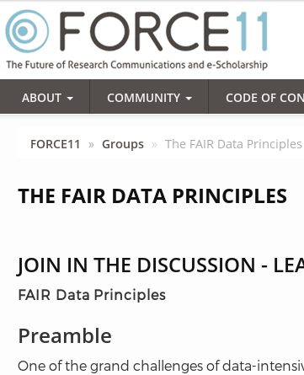
Action: Data citations and metadata
What is FAIR?
Findable,
Accessible,
Interoperable, and
Re-usable

Slide 41
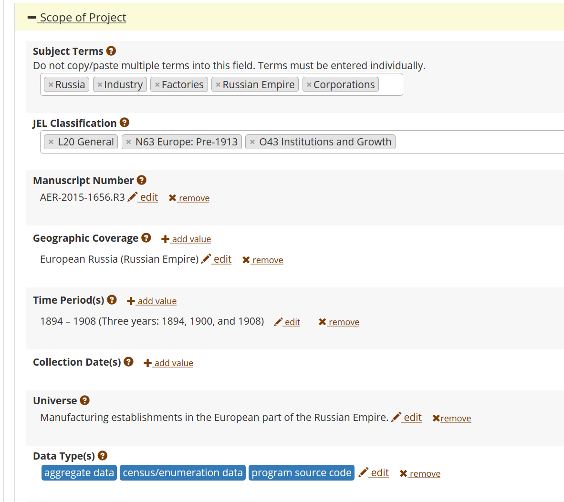
FAIR data principles rely on metadata
Notes:
Show metadata for this page

Slide 42
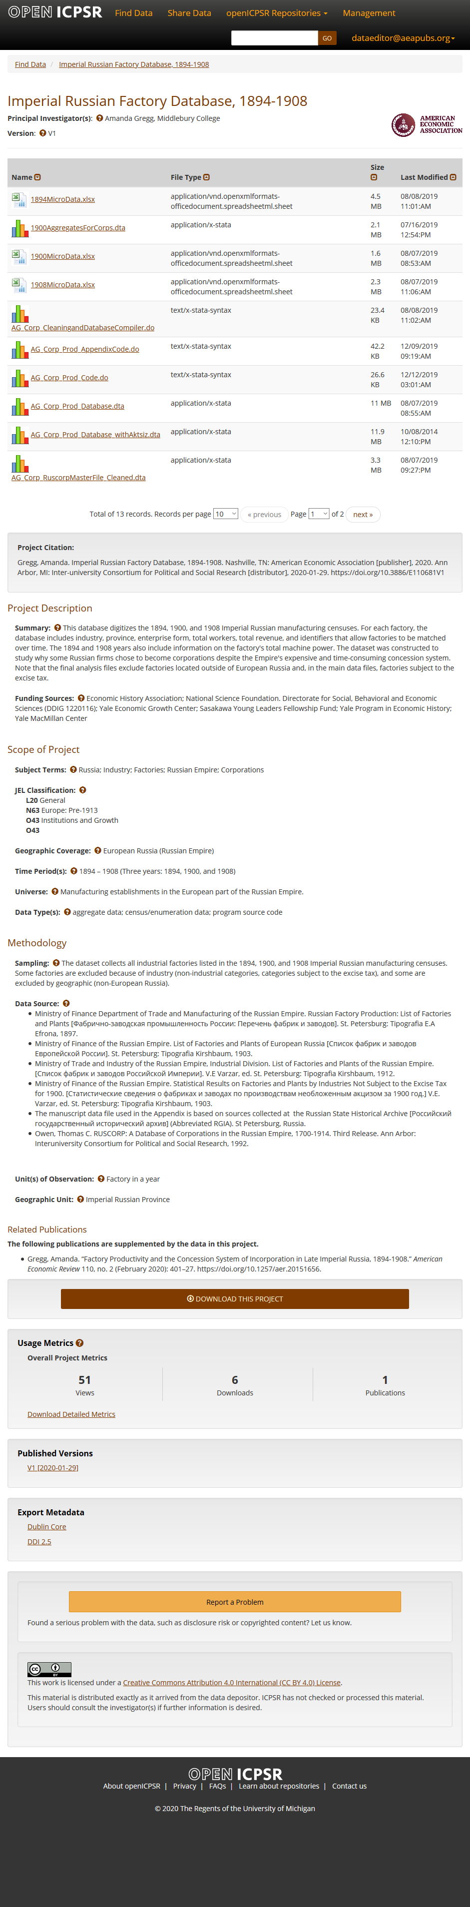

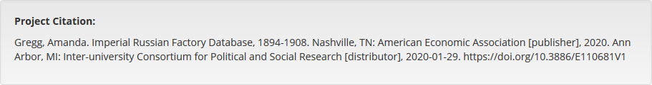
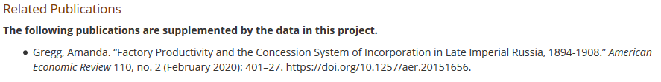

Slide 43
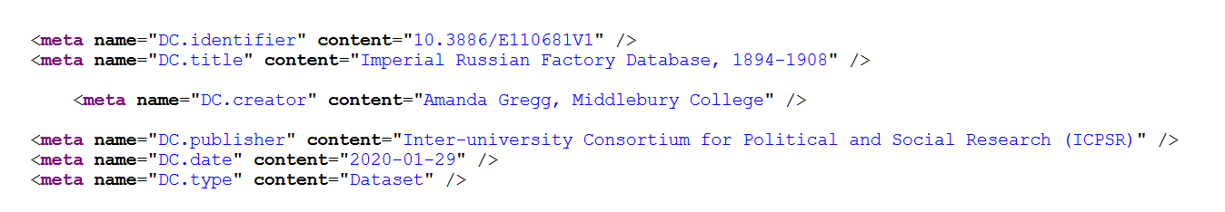

Slide 44
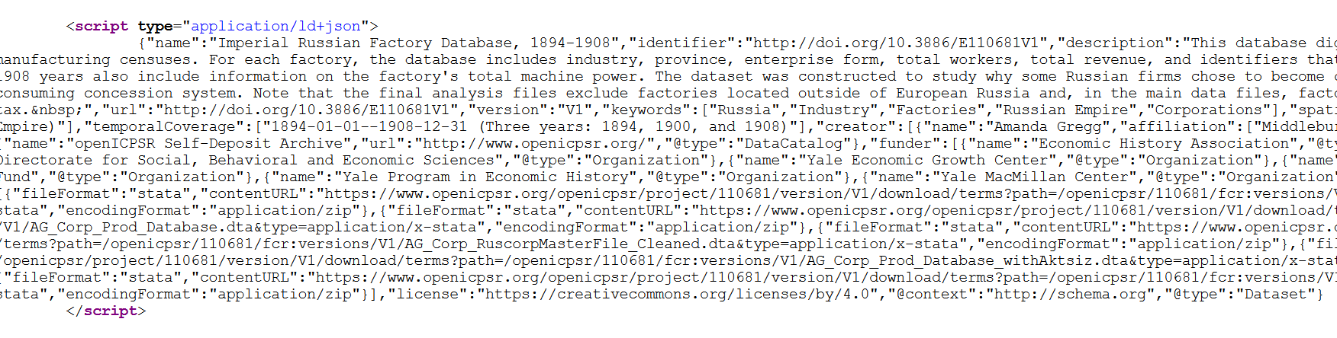

Slide 45
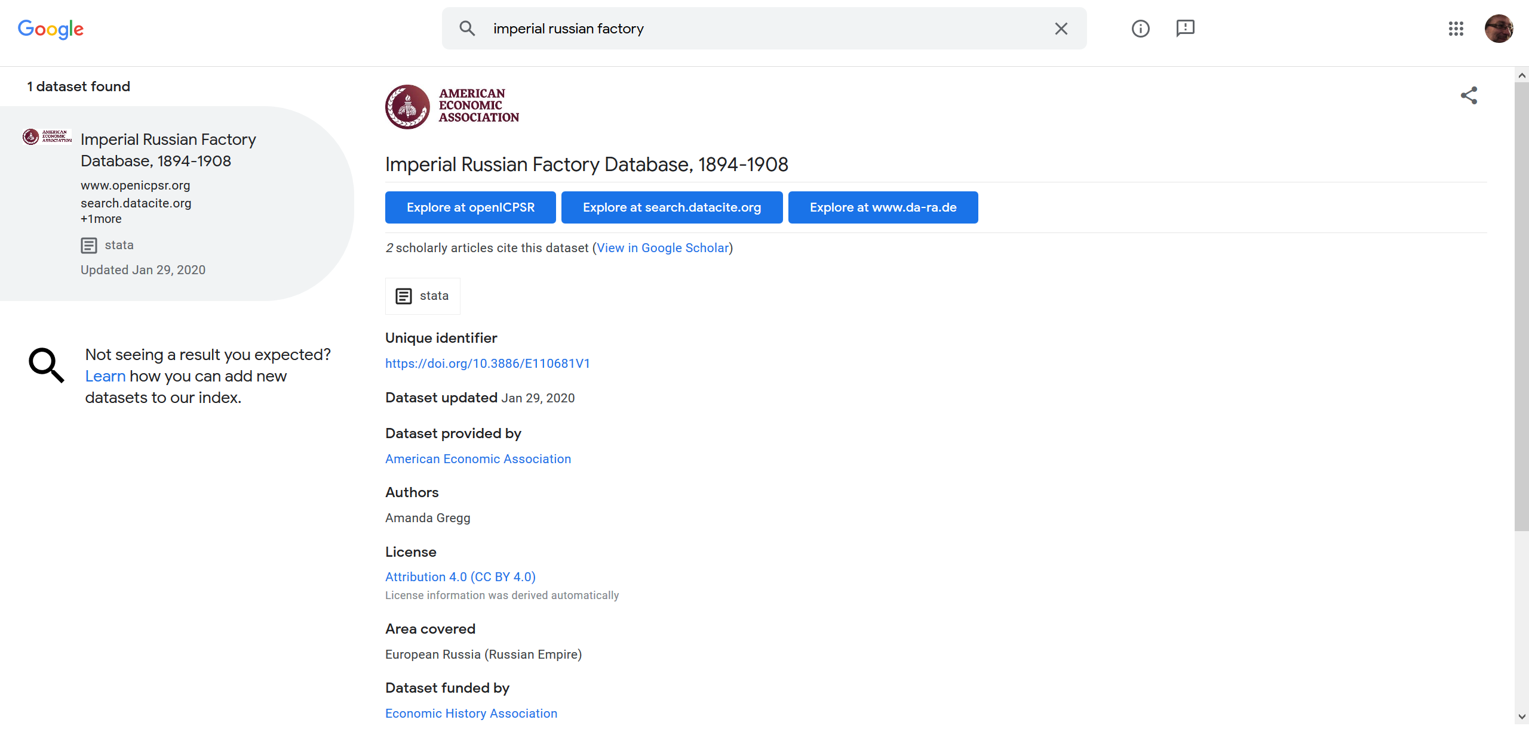
… and findability relies on metadata

Slide 46
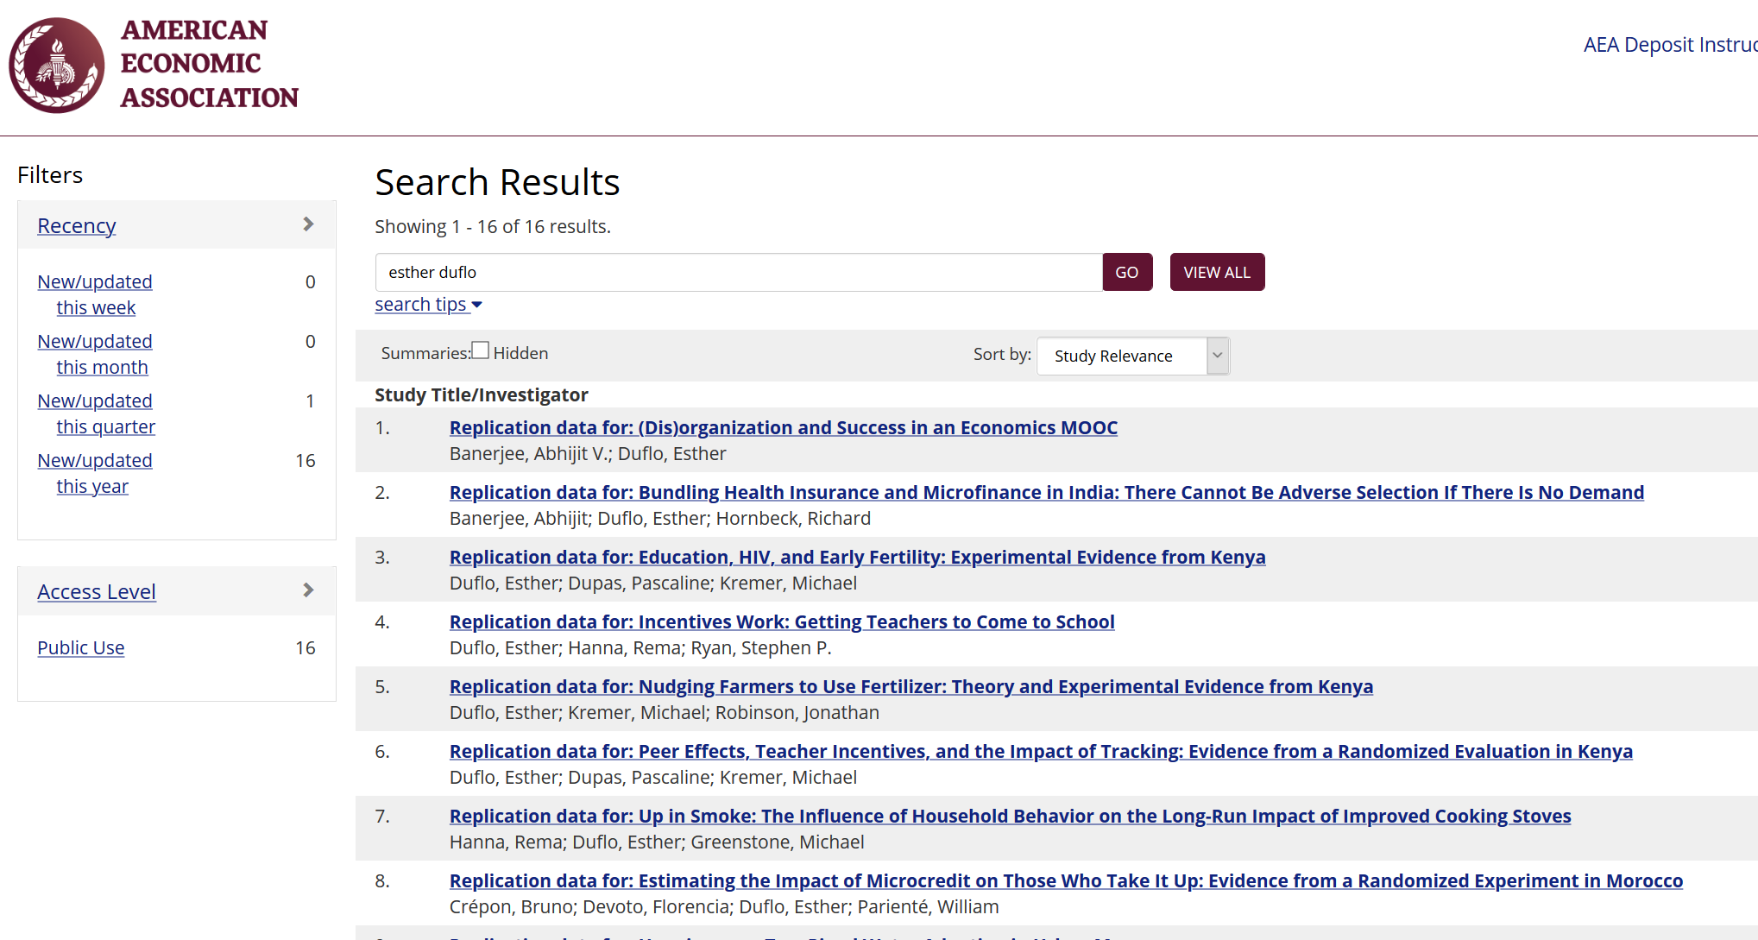

Slide 47
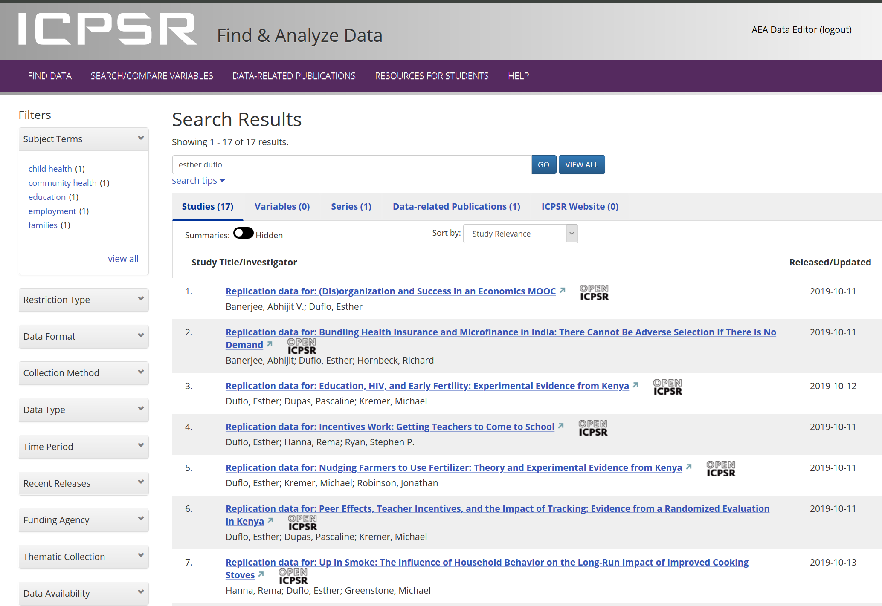

Slide 48
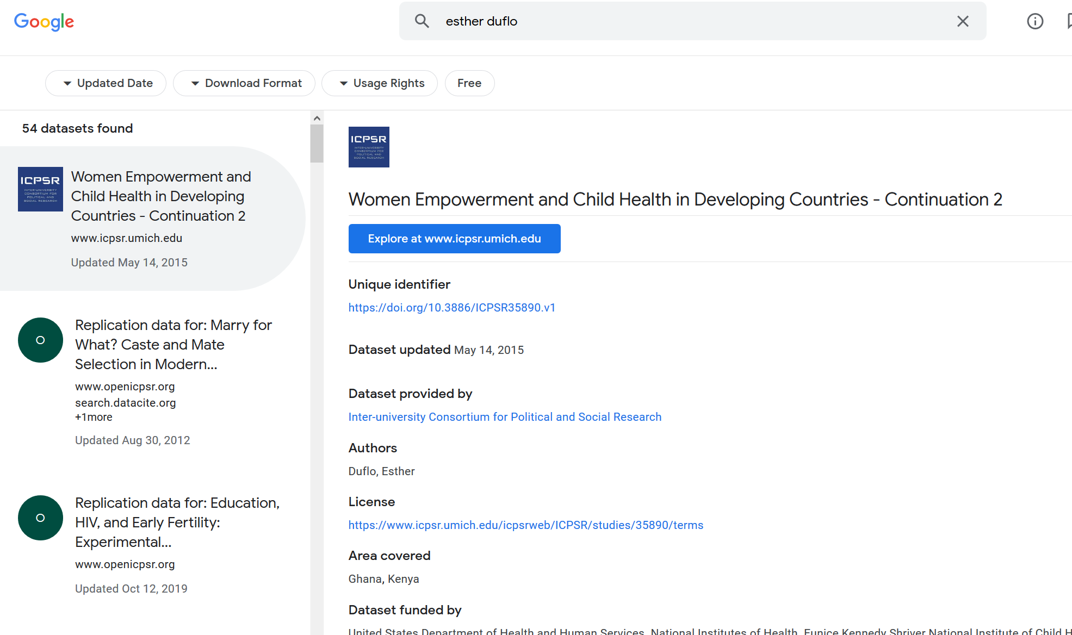

Slide 49
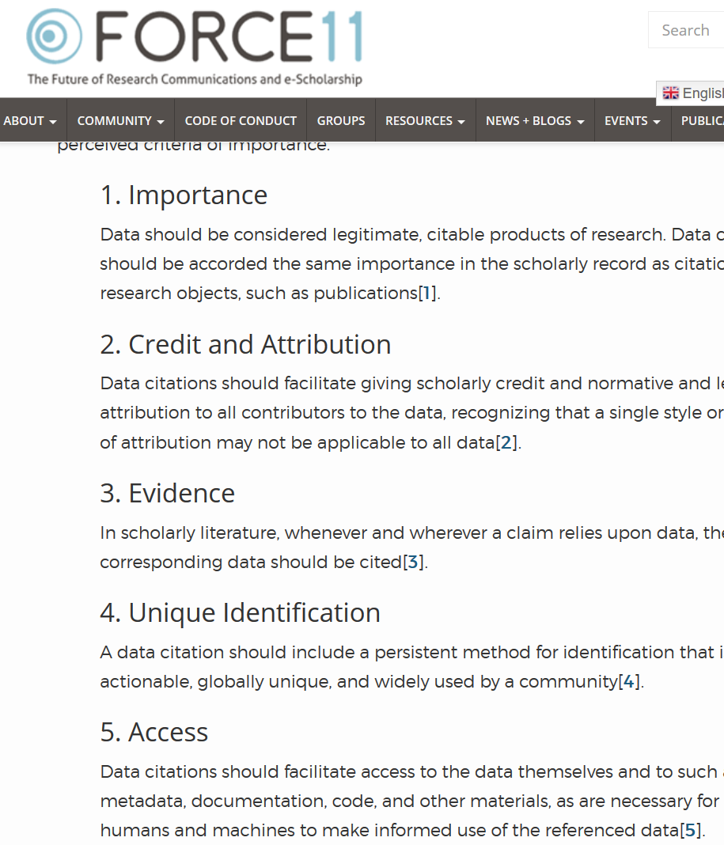

Starts with Data Citations
Data Citation Principles
Image of a standard data citation
Data Citation Synthesis Group: Joint Declaration of Data Citation Principles. Martone M. (ed.) San Diego CA: FORCE11; 2014 [https://www.force11.org/group/joint-declaration-data-citation-principles-final].

Slide 50
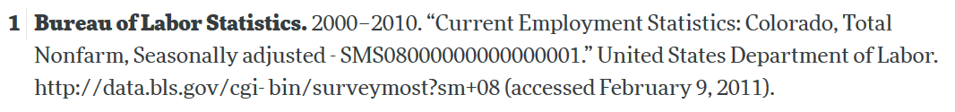
Starts with Data Citations
Data Citation Principles
Image of a standard data citation
Data Citation Synthesis Group: Joint Declaration of Data Citation Principles. Martone M. (ed.) San Diego CA: FORCE11; 2014 [https://www.force11.org/group/joint-declaration-data-citation-principles-final].

Slide 51
Observation 3
Social scientists are not trained to cite data

Slide 52
Citing restricted-access data
“Well, I can’t download the data, so I can’t cite it.”

Slide 53
Some practical tips
(based on 1000 articles)

Slide 54
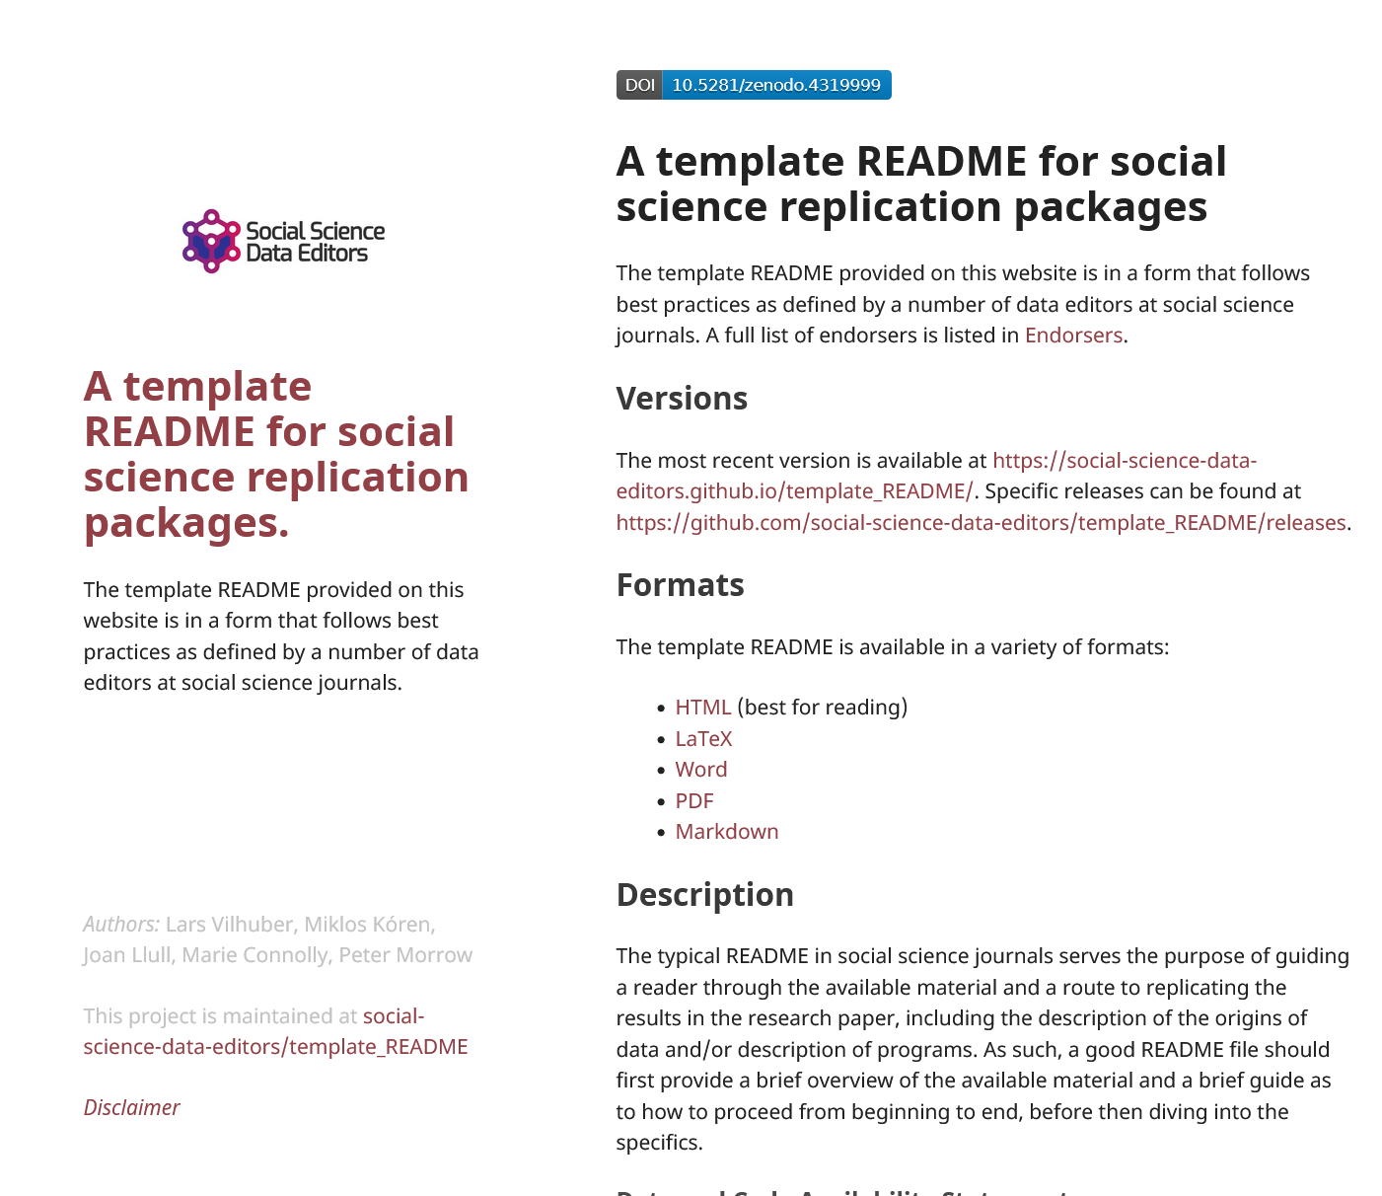
1. Computational empathy
Focal reader: your next RA in 4 years
Interaction: you hand them your README, but don’t have time to go through all the details…
Budget constraint: It shouldn’t take too many RA hours
Time constraint: It shouldn’t take more than 1 week to “get it”

Slide 55
Solution 1: Computational Empathy
Use the Social Science Data Editors’ template README https://doi.org/10.5281/zenodo.4319999

Slide 56
Keeping track: Students and Researchers
Computational empathy Consider the next person to run the analysis, and don’t assume too much

Slide 57
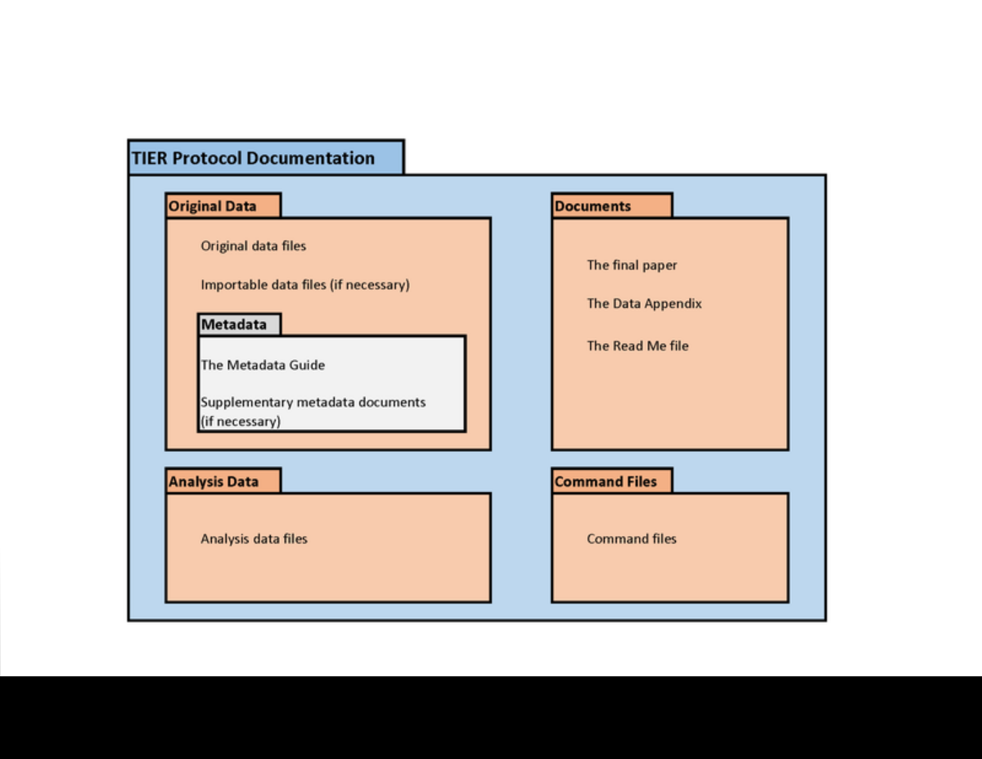
2. Keeping track of data: Data provenance
Keep all information as you collect data
See TIER Protocol for good and simple guidance
If you must use a point-and-click tool, keep detailed instructions
Also: obsolescence
Try to use API, bulk download, or packages that allow for extraction
Also: obsolescence of API

Slide 58
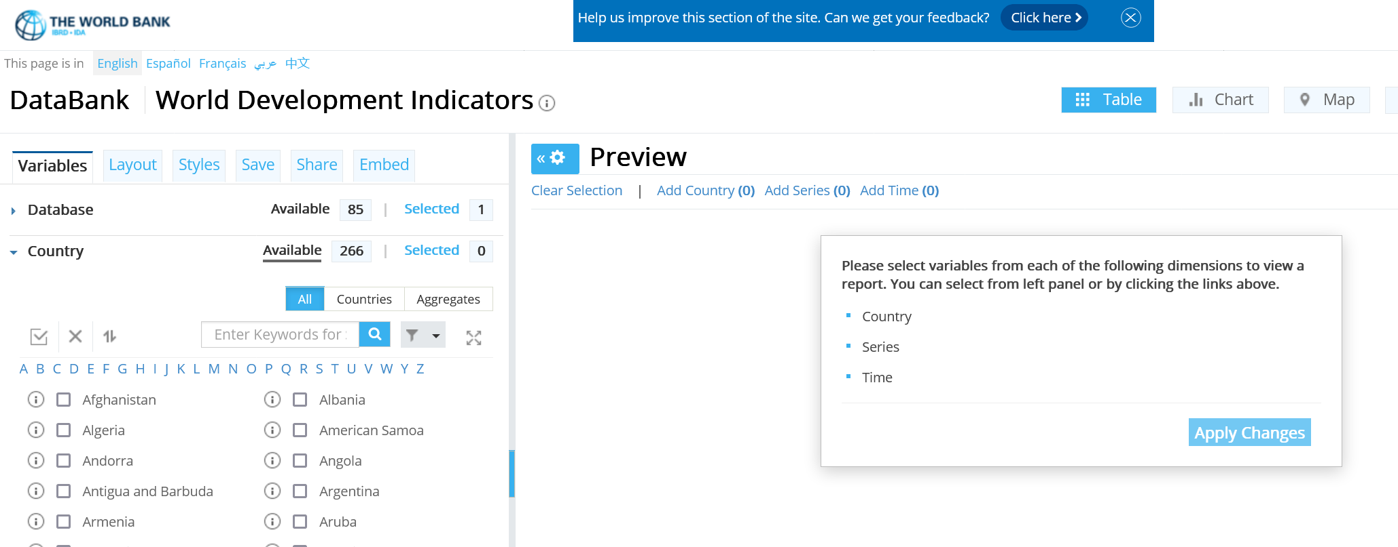
API? But the interface is so cool!
World Development Indicators

Slide 59
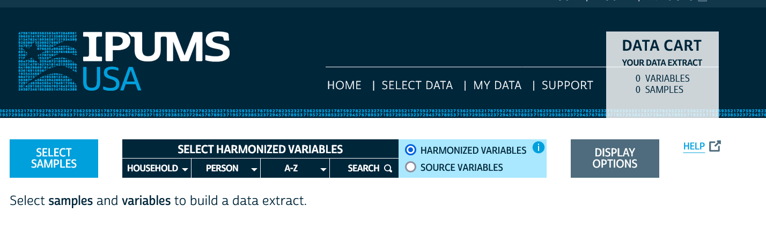
API? But the interface is so cool!
IPUMS

Slide 60
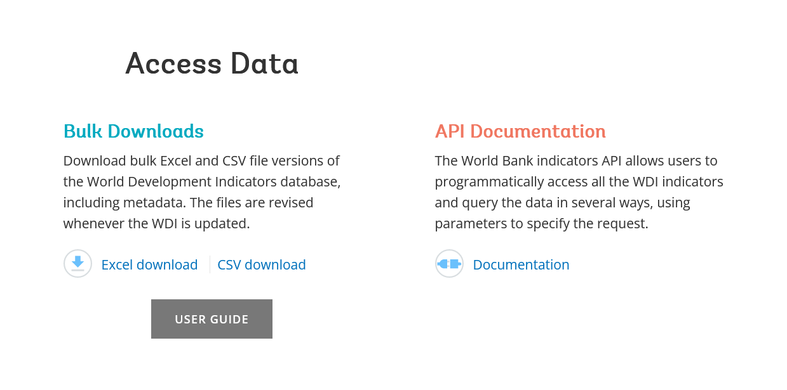
API or Bulk Download
World Development Indicators

Slide 61
API or Bulk Download
World Development Indicators
. ssc install wbopendata
. wbopendata, country(ago;bdi;chi;dnk;esp) indicator(sp.pop.0610.fe.un) /// > year(2000:2010) clear long

Slide 62
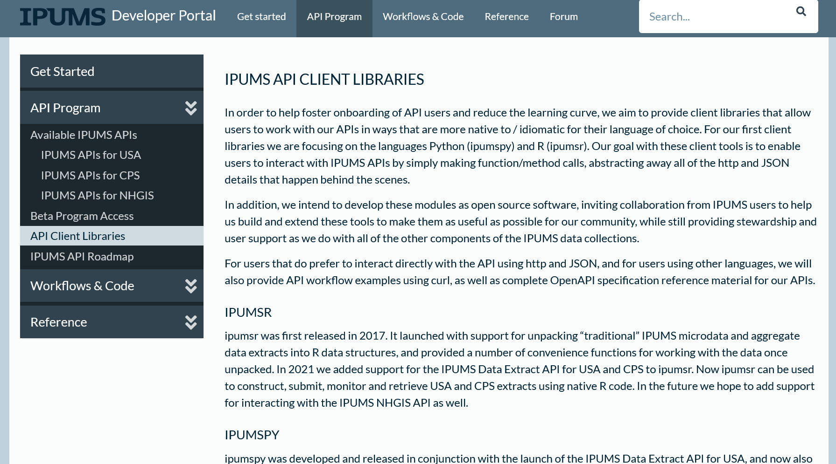
API or Bulk Download
IPUMS (beta)

Slide 63
2. Keeping track of data:
Don’t forget to check the TERMS of USE!

Slide 64
Observation 4
(Academic) Social scientists do not read the terms of use

Slide 65
Because you may not be able to provide others with a copy of the data (legally)…

Slide 66
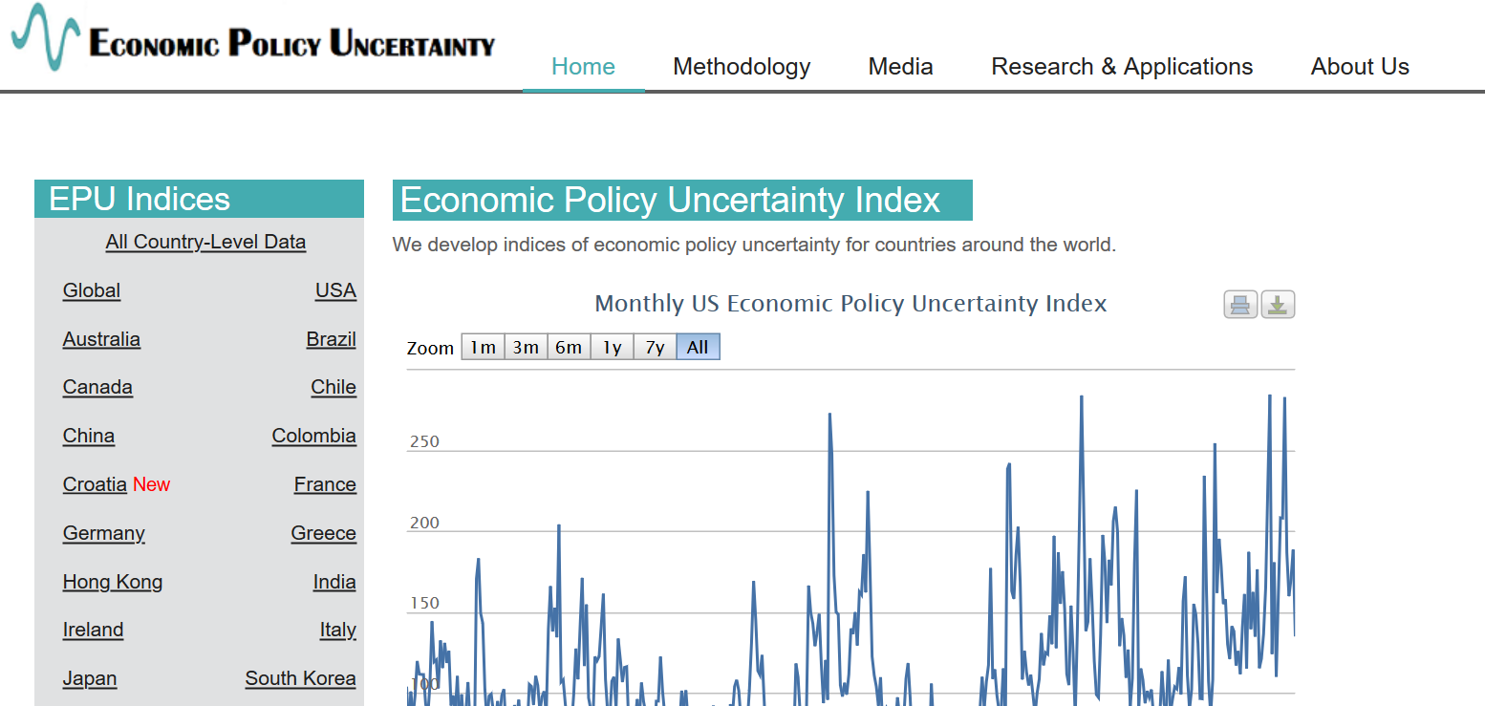
Example 2: Academic data publisher

Slide 67

Example 2: Academic data publisher

Slide 68

Example 2: Academic data publisher-new!

Slide 69
Rights to use data
You browsed a website
You purchased the data
You signed a data use agreement
You created the data (lab experiment)
You had survey respondents consent to use (IRB approval!)

Slide 70
Rights to distribute the data
If you created the data, you decide.
If you got it from somewhere else:
READ THE TERMS OF USE / DATA USE AGREEMENT / CLICK-THROUGH / ETC.

Slide 71
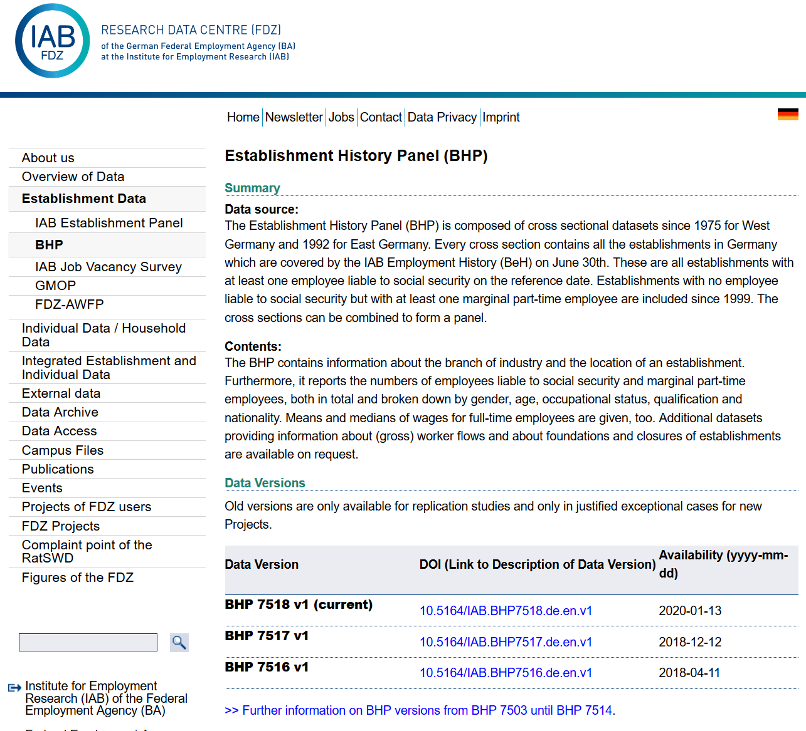
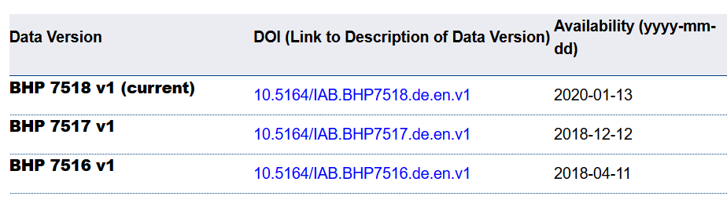
Example 4: German Restricted-access

Slide 72

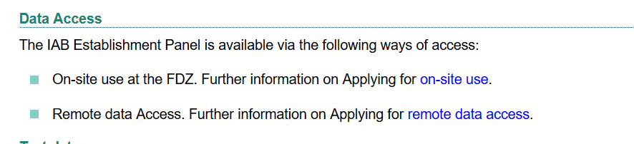
Example 4: German Restricted-access

Slide 73
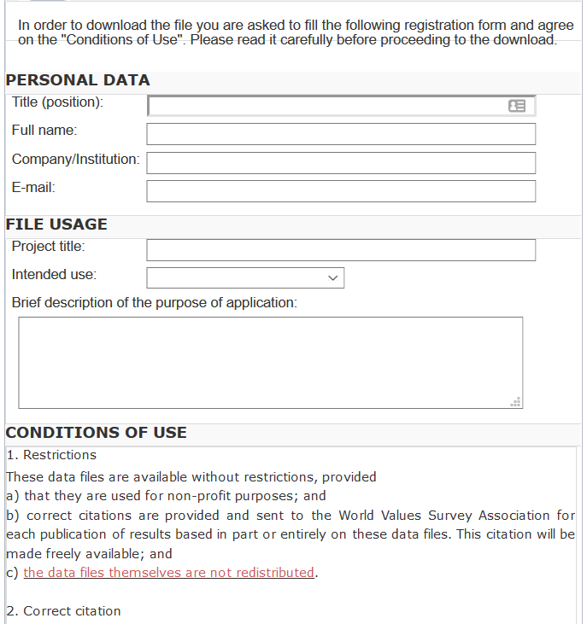
And we check them!
What does the site say?
Please use the following citation when referring to this file in the different versions: Inglehart, R., C. Haerpfer, A. Moreno, C. Welzel, K. Kizilova, J. Diez-Medrano, M. Lagos, P. Norris, E. Ponarin & B. Puranen et al. (eds.). 2014. World Values Survey: Round Six - Country-Pooled Datafile Version: www.worldvaluessurvey.org/WVSDocumentationWV6.jsp. Madrid: JD Systems Institute.
Is that in the README / Paper/ Appendix?
Are all the conditions met/described?

Slide 74
Solution 2: Data Provenance
Keep detailed notes
script as much as possible
(also: Use the Social Science Data Editors’ template README)

Slide 75
Keeping track: Students and Researchers
Computational empathy Consider the next person to run the analysis, and don’t assume too much
Track data (provenance) even when using API, especially when manually downloading, keep in mind what the next downloader may see/find/receive, terms of use

Slide 76
Coding for Reproducibility

Slide 77
Lesson 1: Computational empathy
= “Pity the poor replicator”

Slide 78

Streamlining replication packages
Master script preferred
Least amount of manual effort
No manual manipulation
“Change the parameter to 0.2, then run the code again”
No manual copying of results
Write out/save tables and figures using packages
Compute all numbers in package
No manual install of packages
Use a script to create all directories, install all necessary packages/requirements/etc.
Clear instructions!

Slide 79
Observation 5
(Academic) Social scientists do not read the manual… (or at least not some key parts)

Slide 80
Extreme examples
Matlab-based simulation
Real example, 10 figures, 4 panels each
For Figure 5a, comment line 52, uncomment line 151, run the code, then copy the figure into your document.
For Figure 5b, comment line 151 again, leave line 52 commented, and change the parameter on line 75 to “3”
….

Slide 81
Extreme examples
Matlab-based simulation
Real example, 10 figures, 4 panels each
For Figure 5a, comment line 52, uncomment line 151, run the code, then copy the figure into your document.
For Figure 5b, comment line 151 again, leave line 52 commented, and change the parameter on line 75 to “3”
….
Write re-usable code
Use primitive I/O to read parameter files

Slide 82
Extreme examples
Stata-based estimation
4 variants
Run the data creation programs, then copy the data to Folder A
Copy programs “b.do” and “c.do” from Folder A to Folder B, but modify “c.do” on line 20
Once done, convert the output from “d.do” to a Matlab file, and run the simulation in Folder B/C
….

Slide 83
Extreme examples
Stata-based estimation
4 variants
Run the data creation programs, then copy the data to Folder A
Copy programs “b.do” and “c.do” from Folder A to Folder B, but modify “c.do” on line 20
Once done, convert the output from “d.do” to a Matlab file, and run the simulation in Folder B/C
….
Re-use code files (ado)
Use relative or root-relative paths

Slide 84
Ideal setup
1 program to prepare the setup
Installs all packages
Creates all directories
1 program (or a very small number) that creates the rest
Possibly with macros/ ado files/ subroutines
Possibly with parameter files that might differ per directory
All tables and figures are output programmatically
Setting up can be done in all languages
Matlab, Stata, R, Python, Fortran
Subroutines exist in all languages
You might need to learn how!
Ability to output figures and tables (Excel, LaTeX) exist in all languages

Slide 85
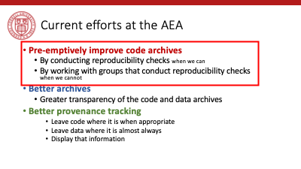
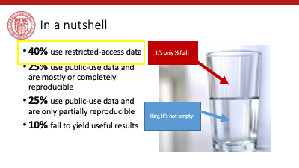
Tension between access and reproducibility

Slide 86


Verification services

Slide 87
Assume replicators can access the data
Sometimes we (=AEA) cannot
We will still check if the code seems complete
We will still verify that all data that *can* be provided have been provided
Plausibility checks
Sometimes we can:
In the past, we have worked with
French, Brazilian, and US confidential admin data
Purchased commercial data (Twitter, Indian GDP)
Proprietary data under NDA/DUA (Ebay)
Data with application procedure (Chinese Panel, Demographic and Health Survey, European establishment data)
Remotely or locally

Slide 88
Solution 3: Learn basics of programming
Code reproducibly
(and do so right from the start)
(also: way easier to describe in the Social Science Data Editors’ template README)

Slide 89
Keeping track: Students and Researchers
Computational empathy Consider the next person to run the analysis, and don’t assume too much
Track data even when using API, especially when manually downloading, keep in mind what the next downloader may see/find/receive, terms of use
Learn the basics of programming code reproducibly, use parameter files, re-usable code, robust file structure

Slide 90
That’s a lot of stuff to learn and remember… I want to focus on the economics!

Slide 91
Keeping track: Students and Researchers
Computational empathy Consider the next person to run the analysis, and don’t assume too much
Track data even when using API, especially when manually downloading, keep in mind what the next downloader may see/find/receive, terms of use
Learn the basics of programming code reproducibly, use parameter files, re-usable code, robust file structure
Learn to automate Run all code again and again, use APIs to download, use conditional processing to handle various aspects
Preserve it all Use version control, tag releases, preserve data (separately), understand the difference between sharing and preserving

Slide 92
That’s a lot of stuff to learn and remember… I want to focus on the economics!

Slide 93
Support by Institutions

Slide 94
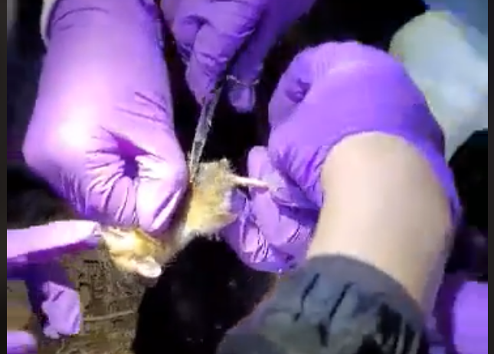
Lesson 3: Support by institutions is insufficient
When should these skills be taught?
These are core “tools of the trade”!
Undergrad, core part of graduate curricula
In other disciplines: students learn how to collect use a pipette, how to tag field mice in the wild…

Slide 95
Lesson 3: Support by institutions is insufficient
Should all of these skills be taught?
How to deposit data
How to set up a compute cluster
Some of these skills fall into other categories, but
Data librarians are understaffed, and not trained in discipline-specific practices
Campus IT has highly varying funding and consulting time
Cross-campus IT practices are nowhere close to compatible

Slide 96
Lesson 3: Support by institutions is insufficient
Institutional funding and mandates are not adequate
Most grant funding in social sciences does not require (or allow!) for this kind of budgeting
Earmarked portions of funds would be great!
(This is slowly coming, NSF and NIH are making progress)
(Most) Universities consider this an external mandate, not part of their “overhead”
“Provide us with an account, and we will do it”
Leads to highly scattershot infrastructure

Slide 97
Lesson 3: Support by institutions is insufficient
Disciplinary institutions need funding
Direct funding: should archives be treated like infrastructure?
This is the case in many NIH archives
Not quite as ubiquitous in social sciences
Where do you want to preserve 1TB per user per day for the next 50 years? It’s not free…
Indirect funding (via grants)
See previous slide

Slide 98
Lesson 3: Support by institutions is insufficient
All institutions need to consider the user experience
Data provenance and preservation would be a lot easier to implement if scripted
Need for APIs both for upload and download (usage)
Some progress: Zenodo and Dataverse (usually Python, sometimes R)

Slide 99
Lesson 3: Support by institutions is insufficient
Integration of computational resources with data resources is highly inadequate
Most journals have “data” policies, but all research compendia have code – this is a problem with many publishers
Most data repositories are optimized for … data. Support for computational code or actual execution is at best preliminary
See CodeOcean, WholeTale, efforts around Dataverse
See various “continuous integration” using Github, Travis CI, etc. but difficult to integrate data

Slide 100
Solution 6: Institutional support
(departments, schools, libraries, IT, universities)
Offer training in adapted tools (not sufficient to just show how to do a Rmarkdown document)
Highlight appropriate community (Zenodo, Dataverse, others) or university sites
Provide streamlined access to some frequently used (open/commercial) tools (AWS/GCS/Azure, CI on Github/others, etc.)

Slide 101
Some thoughts for the role of Faculty
Encourage students to learn new skills outside of economics Even or especially if you do not have the time to do so
Demand reproducibility when reviewing (articles, theses, intermediate reports from students, etc.) automated re-runs on Github, which particular release to review, refusing emailed copies
Incentivize reproducibility For robustness, for efficiency, but also training for exposure to the discipline. Example: Replication Challenges

Slide 102

Please don’t produce irreproducible articles!

Slide 103
The role for journals

Slide 104
Goal: Transportability
Any standards, tools, methods: must be transportable across journals (no custom solutions)

Slide 105

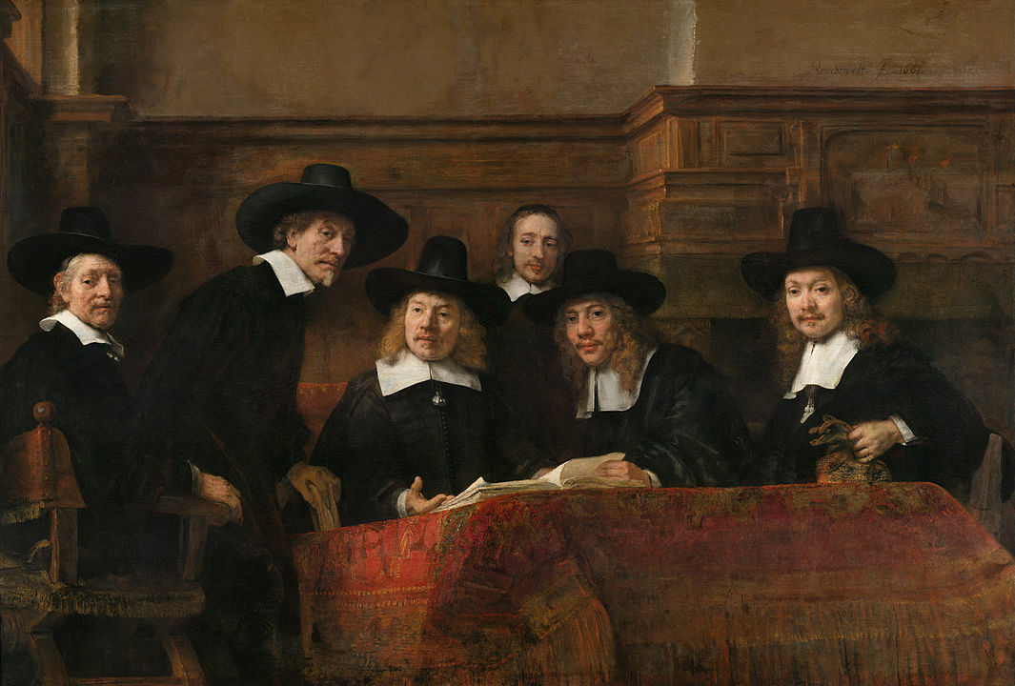
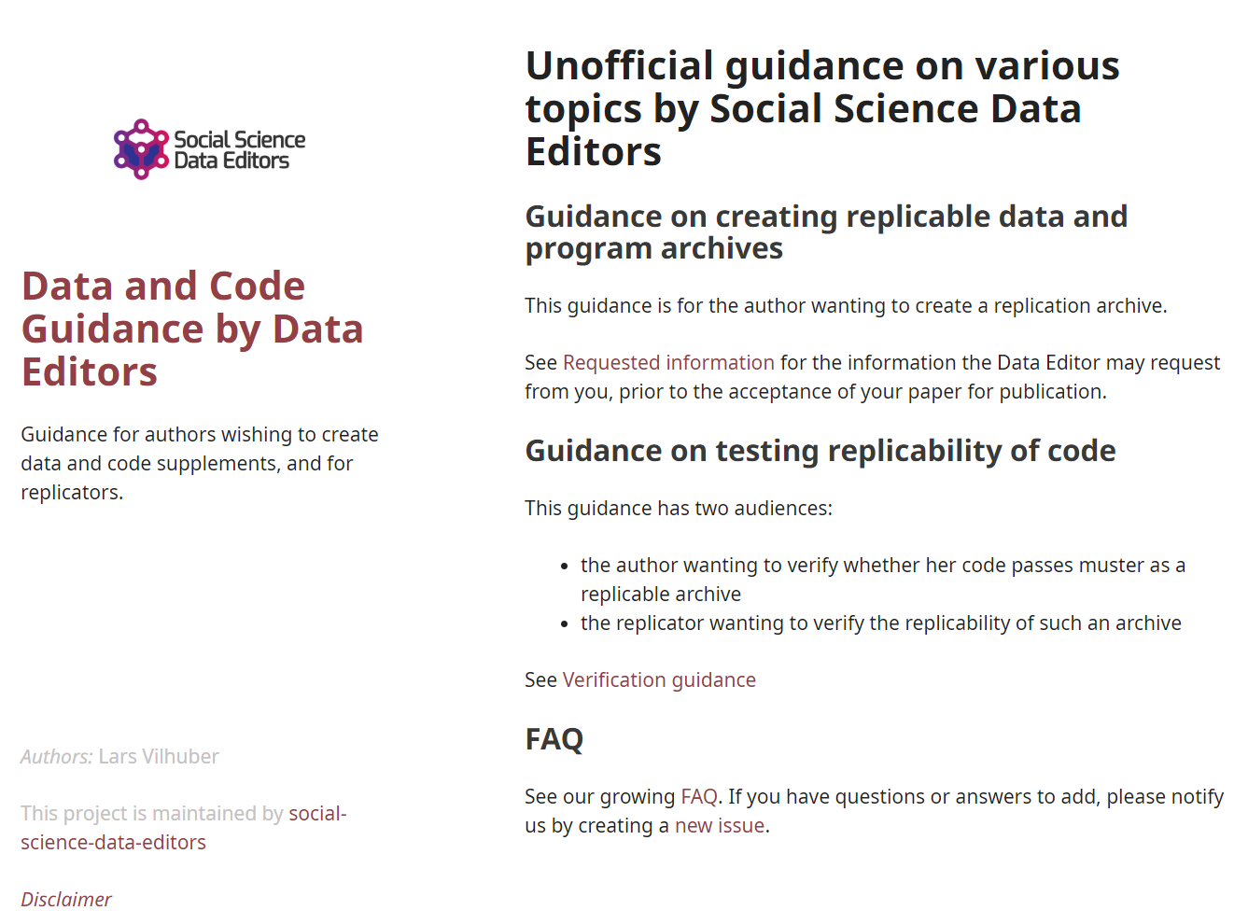
Social science “guild”
https:// social-science -data-editors. github.io/ guidance/

Slide 106
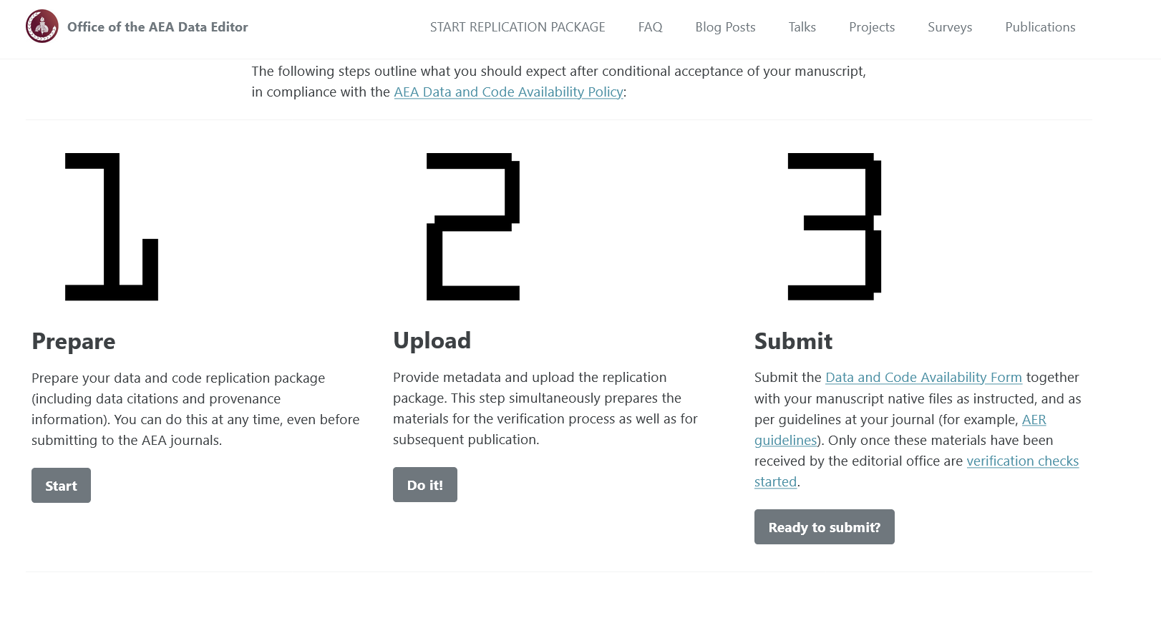

Some resources
https://social-science-data-editors.github.io/guidance/
template README
discussion of licensing
data citation guidance
https://aeadataeditor.github.io/

Slide 107
Thank you!

Slide 108
Reminder: Students and Researchers
Computational empathy Consider the next person to run the analysis, and don’t assume too much
Track data even when using API, especially when manually downloading, keep in mind what the next downloader may see/find/receive, terms of use
Learn the basics of programming code reproducibly, use parameter files, re-usable code, robust file structure
Learn to automate Run all code again and again, use APIs to download, use conditional processing to handle various aspects
Preserve it all Use version control, tag releases, preserve data (separately), understand the difference between sharing and preserving

Slide 110
Example of data provenance

Slide 111
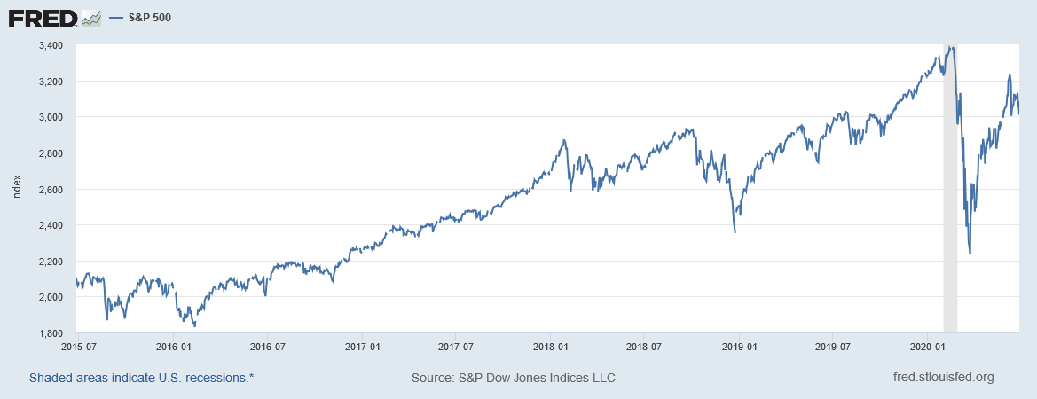
“It’s a file called stockmarket.xlsx”
2101.49
2057.64
2063.11
2077.42
2076.78
0
2068.76
2081.34
2046.68
2051.31
2076.62
2099.60
2108.95
2107.40
2124.29
2126.64
2128.28
2119.21
2114.15
2102.15
2079.65
2067.64
2093.25
2108.57
2108.63
2103.84

Slide 112
“It’s a file called SP500.xlsx”
SP500 | S&P 500, Index, Daily, Not Seasonally Adjusted
Frequency: Daily, Close
observation_date | SP500
2015-06-26 | 2101.49
2015-06-29 | 2057.64
2015-06-30 | 2063.11
2015-07-01 | 2077.42
2015-07-02 | 2076.78
2015-07-03 | 0
2015-07-06 | 2068.76
2015-07-07 | 2081.34
2015-07-08 | 2046.68
2015-07-09 | 2051.31
2015-07-10 | 2076.62
2015-07-13 | 2099.60
2015-07-14 | 2108.95
2015-07-15 | 2107.40
2015-07-16 | 2124.29
2015-07-17 | 2126.64
2015-07-20 | 2128.28

Slide 113
“It’s a file called SP500.xlsx, downloaded from FRED.”
SP500 | S&P 500, Index, Daily, Not Seasonally Adjusted
Frequency: Daily, Close
observation_date | SP500
2015-06-26 | 2101.49
2015-06-29 | 2057.64
2015-06-30 | 2063.11
2015-07-01 | 2077.42
2015-07-02 | 2076.78
2015-07-03 | 0
2015-07-06 | 2068.76
2015-07-07 | 2081.34
2015-07-08 | 2046.68
2015-07-09 | 2051.31
2015-07-10 | 2076.62
2015-07-13 | 2099.60
2015-07-14 | 2108.95
2015-07-15 | 2107.40
2015-07-16 | 2124.29
2015-07-17 | 2126.64
2015-07-20 | 2128.28

Slide 114
“It’s a file called SP500.xlsx, downloaded from FRED.”
S&P Dow Jones Indices LLC. 2020. “S&P 500 [SP500] [dataset]”, retrieved from FRED, Federal Reserve Bank of St. Louis; https://fred.stlouisfed.org/series/SP500, June 26, 2020.
SP500 | S&P 500, Index, Daily, Not Seasonally Adjusted
Frequency: Daily, Close
observation_date | SP500
2015-06-26 | 2101.49
2015-06-29 | 2057.64
2015-06-30 | 2063.11
2015-07-01 | 2077.42
2015-07-02 | 2076.78
2015-07-03 | 0
2015-07-06 | 2068.76
2015-07-07 | 2081.34
2015-07-08 | 2046.68
2015-07-09 | 2051.31
2015-07-10 | 2076.62
2015-07-13 | 2099.60
2015-07-14 | 2108.95
2015-07-15 | 2107.40
2015-07-16 | 2124.29
2015-07-17 | 2126.64
2015-07-20 | 2128.28

Slide 115
“SP500.xlsx, from S&P (2020). Not provided as part of replication package because © S&P. ”
S&P Dow Jones Indices LLC. 2020. “S&P 500 [SP500] [dataset]”, retrieved from FRED, Federal Reserve Bank of St. Louis; https://fred.stlouisfed.org/series/SP500, June 26, 2020.
SP500 | S&P 500, Index, Daily, Not Seasonally Adjusted
Frequency: Daily, Close
observation_date | SP500
2015-06-26 | 2101.49
2015-06-29 | 2057.64
2015-06-30 | 2063.11
2015-07-01 | 2077.42
2015-07-02 | 2076.78
2015-07-03 | 0
2015-07-06 | 2068.76
2015-07-07 | 2081.34
2015-07-08 | 2046.68
2015-07-09 | 2051.31
2015-07-10 | 2076.62
2015-07-13 | 2099.60
2015-07-14 | 2108.95
2015-07-15 | 2107.40
2015-07-16 | 2124.29
2015-07-17 | 2126.64
2015-07-20 | 2128.28

Slide 116
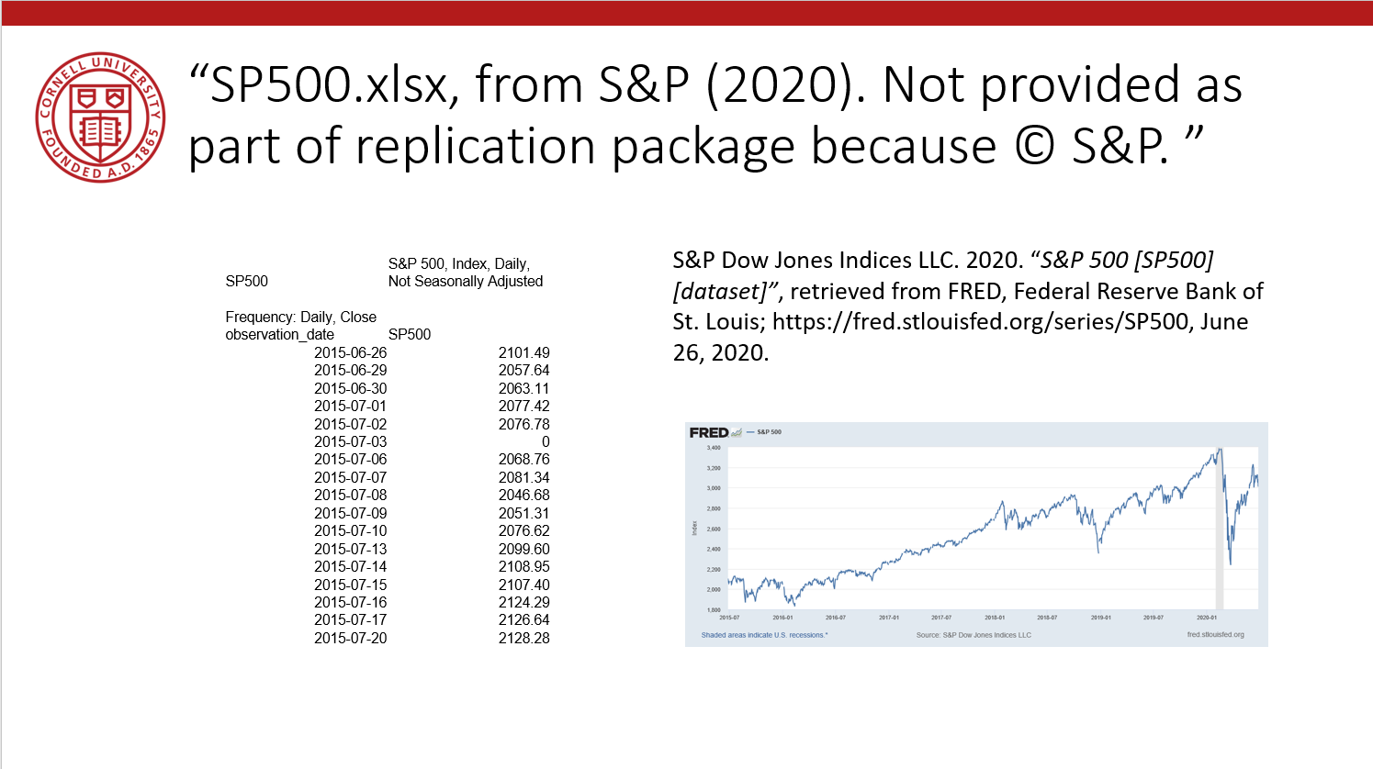
Data Availability Statements
Describes data file, where to get it, how to get it, and any conditions of obtaining it

Slide 117
Data Citations

Slide 118
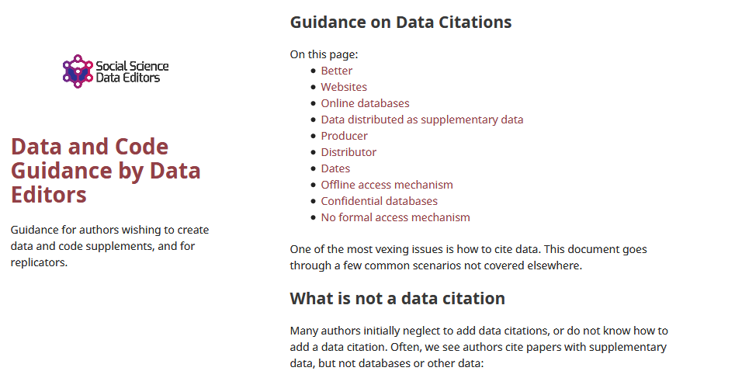
Data citations
Creating specific guidance in the absence of strong discipline-specific guidance
https://social-science-data-editors.github.io/guidance/addtl-data-citation-guidance.html

Slide 119
Example 4: German Restricted-access

Slide 120
Data Citation
Attributes the file to the proper source

Slide 121
Element of a (data) citation
ICPSR notes that a citation should include the following items:
Author
Title
Distributor
Date
Version
Persistent identifier
Suggested Citation:
S&P Dow Jones Indices LLC, S&P 500 [SP500], retrieved from FRED, Federal Reserve Bank of St. Louis; https://fred.stlouisfed.org/series/SP500, June 26, 2020.

Slide 122
Element of a (data) citation
ICPSR notes that a citation should include the following items:
Author
Title
Distributor
Date
Version
Persistent identifier
Constructed Citation:
Institute for Employment Research (IAB), Establishment History Panel 1975-2018. Accessed via the Research Data Centre (FDZ) of the German Federal Employment Agency DOI: 10.5164/IAB.BHP7518.de.en.v1 June 26, 2020.

Slide 123
Element of a (data) citation
ICPSR notes that a citation should include the following items:
Author
Title
Distributor
Date
Version
Persistent identifier
Constructed Citation:
US Census Bureau, Longitudinal Business Database (LBD) 1975-2018. Last accessed via the Federal Statistical Research Data Centre (FSRDC) June 26, 2020.

Slide 124
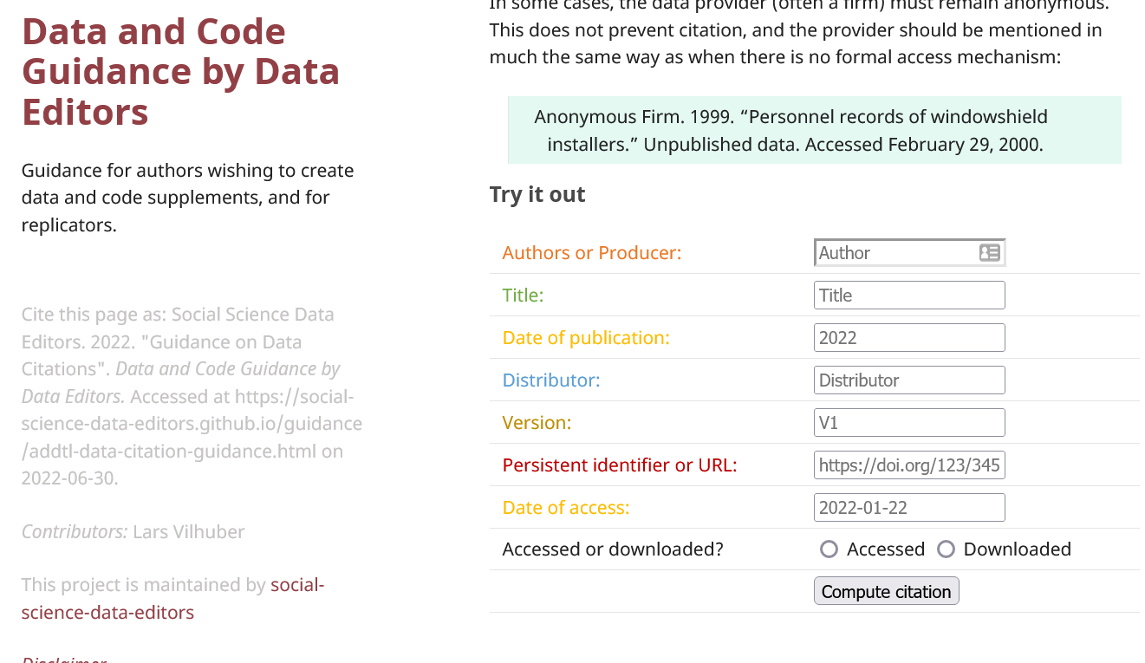
Try it out yourself
Construct an (approximate) data citation
https://social-science-data-editors.github.io/guidance/addtl-data-citation-guidance.html#try-it-out

Slide 125
Data: Citations, Access, Rights
Any data can be cited – even if you can’t download it
Any data that you accessed … can have that access be described
But caution: It should be such that others can also repeat the access!
Just because you “have” the data does not mean you can give it to others
Also: distinguish between “sharing” and “publishing”
Know your terms of use!

Slide 126
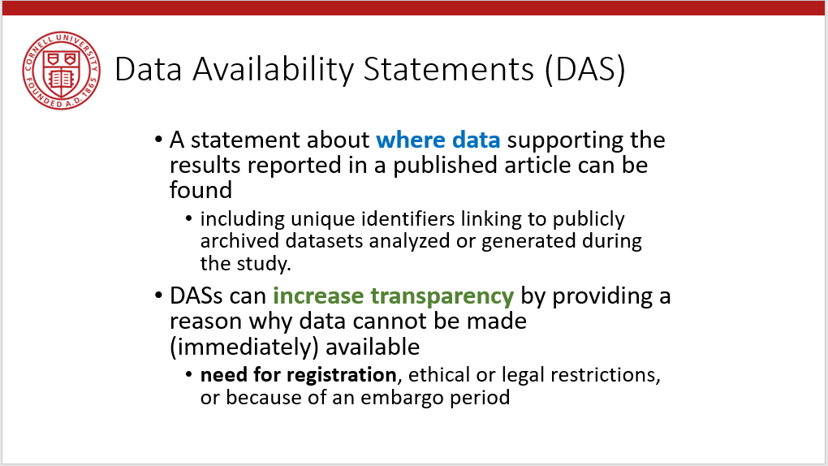
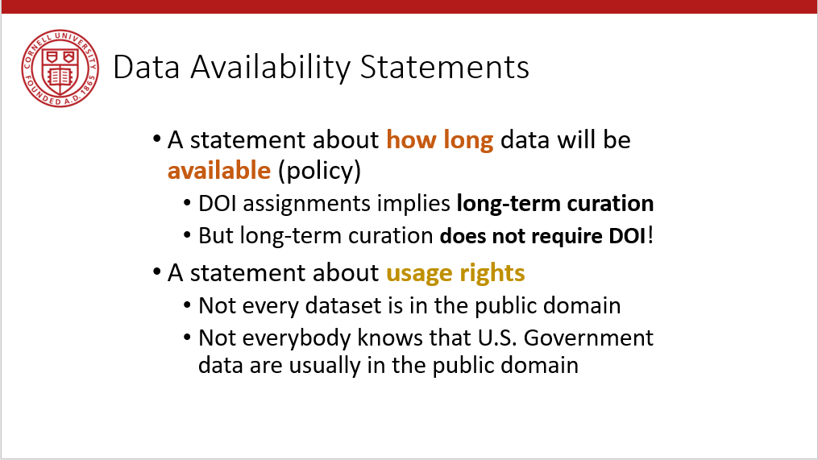
Provide data citations (in manuscript) and data availability statements (in README or appendix)

Slide 127
Solution 3: Data Citations
Cite every data source
(not only the paper that describes the source!)
(also: add them to the Social Science Data Editors’ template README)

